Slide 1
Arduino Ethernet Shield
Soundararajan dhakshinamoorthy

Slide 2
Overview
Connect it to your network with the RJ45 cable.
Based on Wiznet W5100 Ethernet chip.
Uses the Ethernet library.
PoE module designed to extract power from CAT5 cable
IEEE 802.3af complaint
Uno communicates with pins 10,11,12,13. They cannot be used for general IO

Slide 3
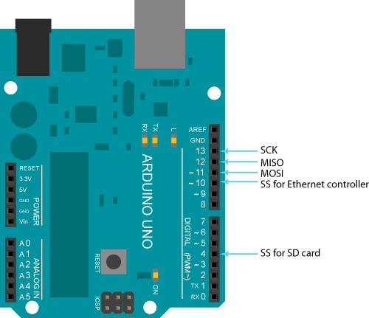
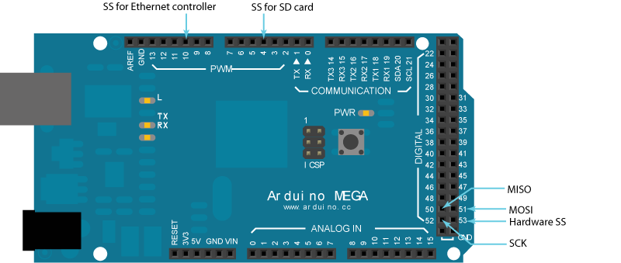
Shield routing

Slide 4
Ethernet WebServer
The Setup
The IP Address configuration
The data that is served
Serial monitor

Slide 5
Your Turn
Connecting from your Android / iPhone / PC to this server
SSID : NETGEAR28
PASSWORD : littletullip150
IP Configuration
Open Browser
http://192.168.1.177

